Slide 1
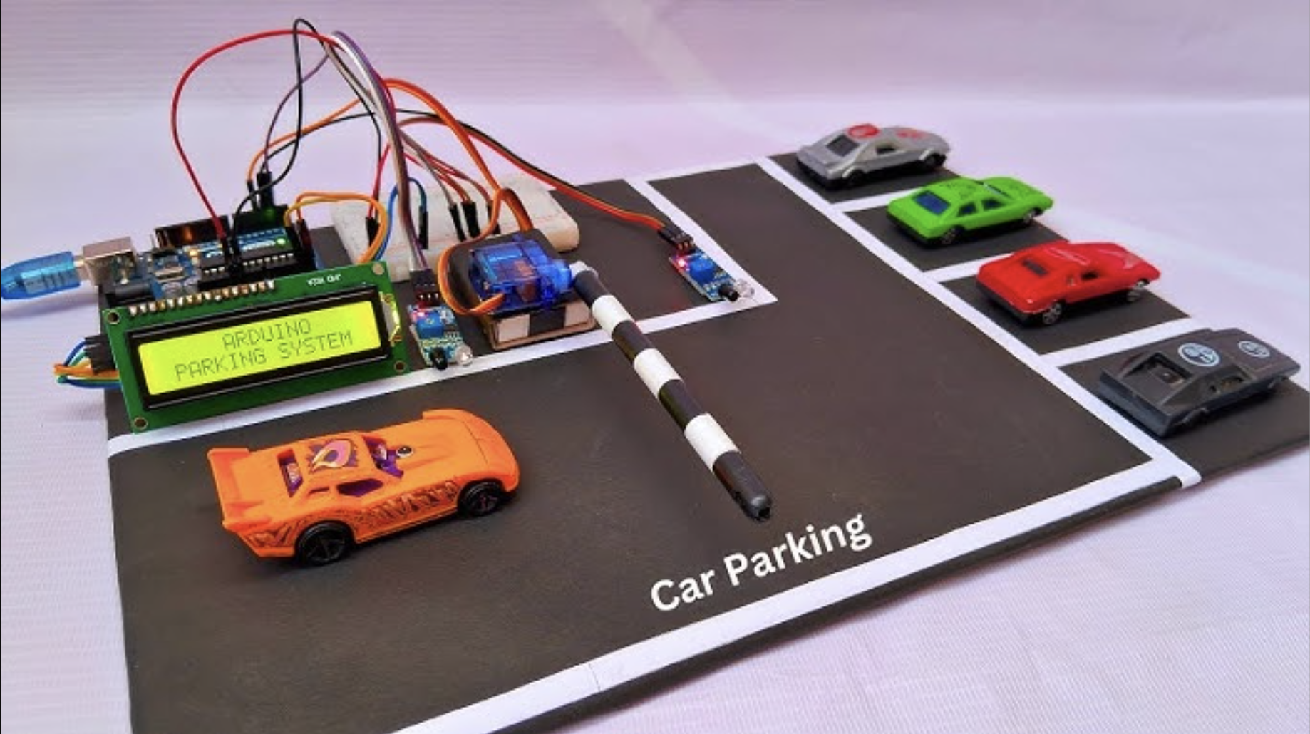
OPTIMIZING URBAN MOBILITY: A SMART PARKING SYSTEM
Team 1:
Jenil Maheshwari (RA2311003011121)
Ashneet Jha (RA2311003011137) Aditya Prasad (RA2311003011138)

Slide 2

INTRODUCTION TO SMART PARKING
Overview:
The Smart Parking System is an innovative solution designed to address the challenges of parking management in urban areas.
It utilizes modern technology to automate the process of finding and managing parking spaces, providing real-time data and control.
Importance:
Urban areas often face significant parking issues, leading to traffic congestion and wasted time.
An efficient parking system can alleviate these problems, making it easier for drivers to find parking and reducing overall traffic.

Slide 3
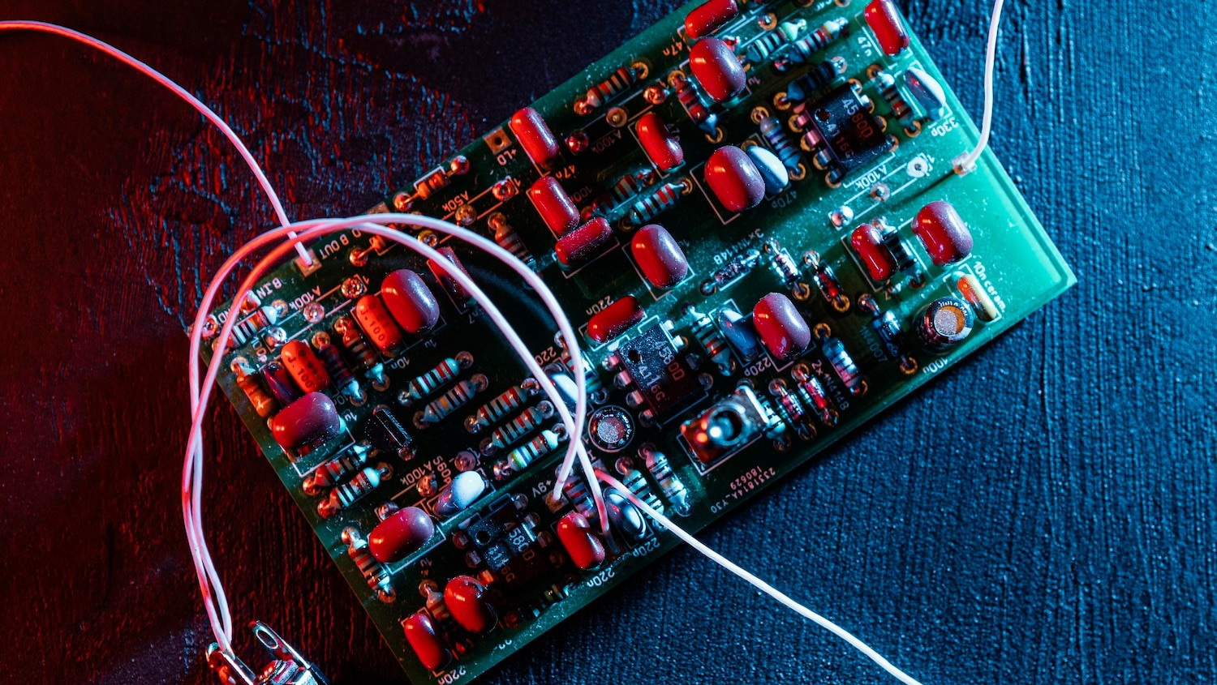
ARDUINO UNO: THE HEART OF THE SYSTEM
Role: The Arduino UNO acts as the central processing unit of the system, coordinating all the components.
Importance: It processes inputs from the sensors and controls outputs such as the LCD screen and servo motor, ensuring smooth operation.
Details: The Arduino UNO is a versatile and widely-used microcontroller, known for its ease of use and reliability.

Slide 4
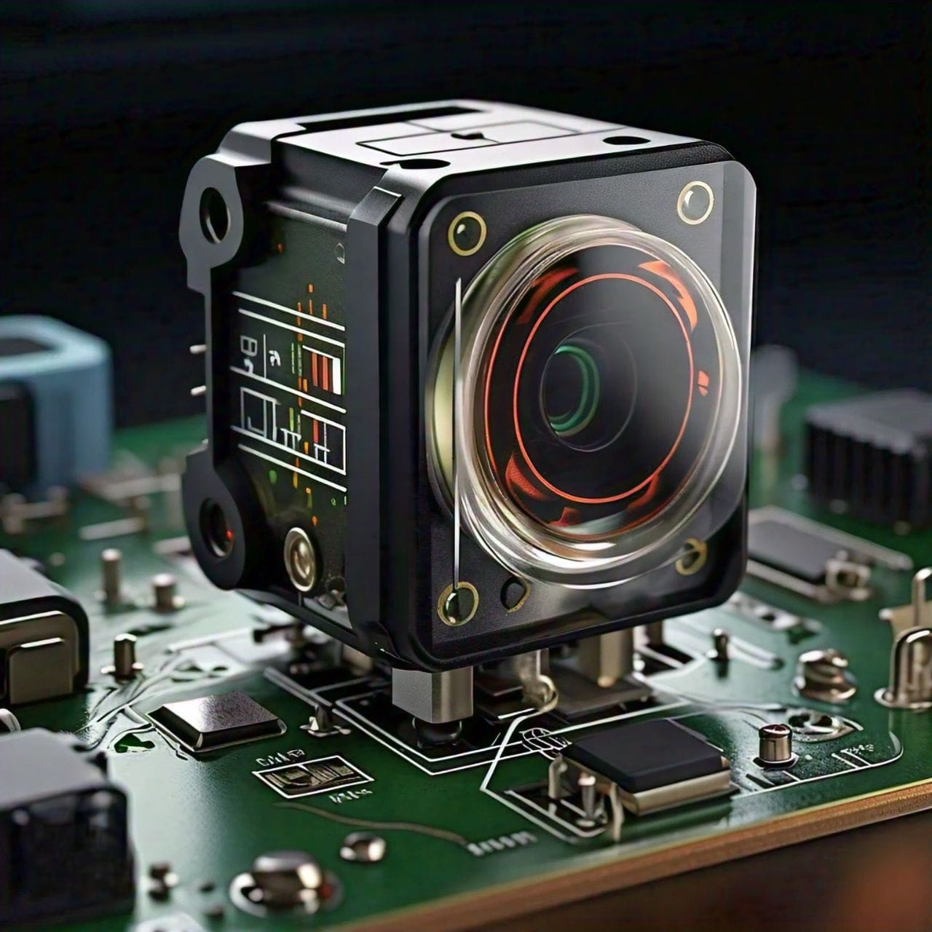
IR Proximity Sensors: Vehicle Detection
Function: These sensors detect the presence of vehicles in each parking slot.
Benefit: They provide accurate, real-time data on the occupancy status of parking slots.
Details: Two RI proximity sensors are strategically placed to cover multiple parking slots, ensuring comprehensive monitoring.

Slide 5
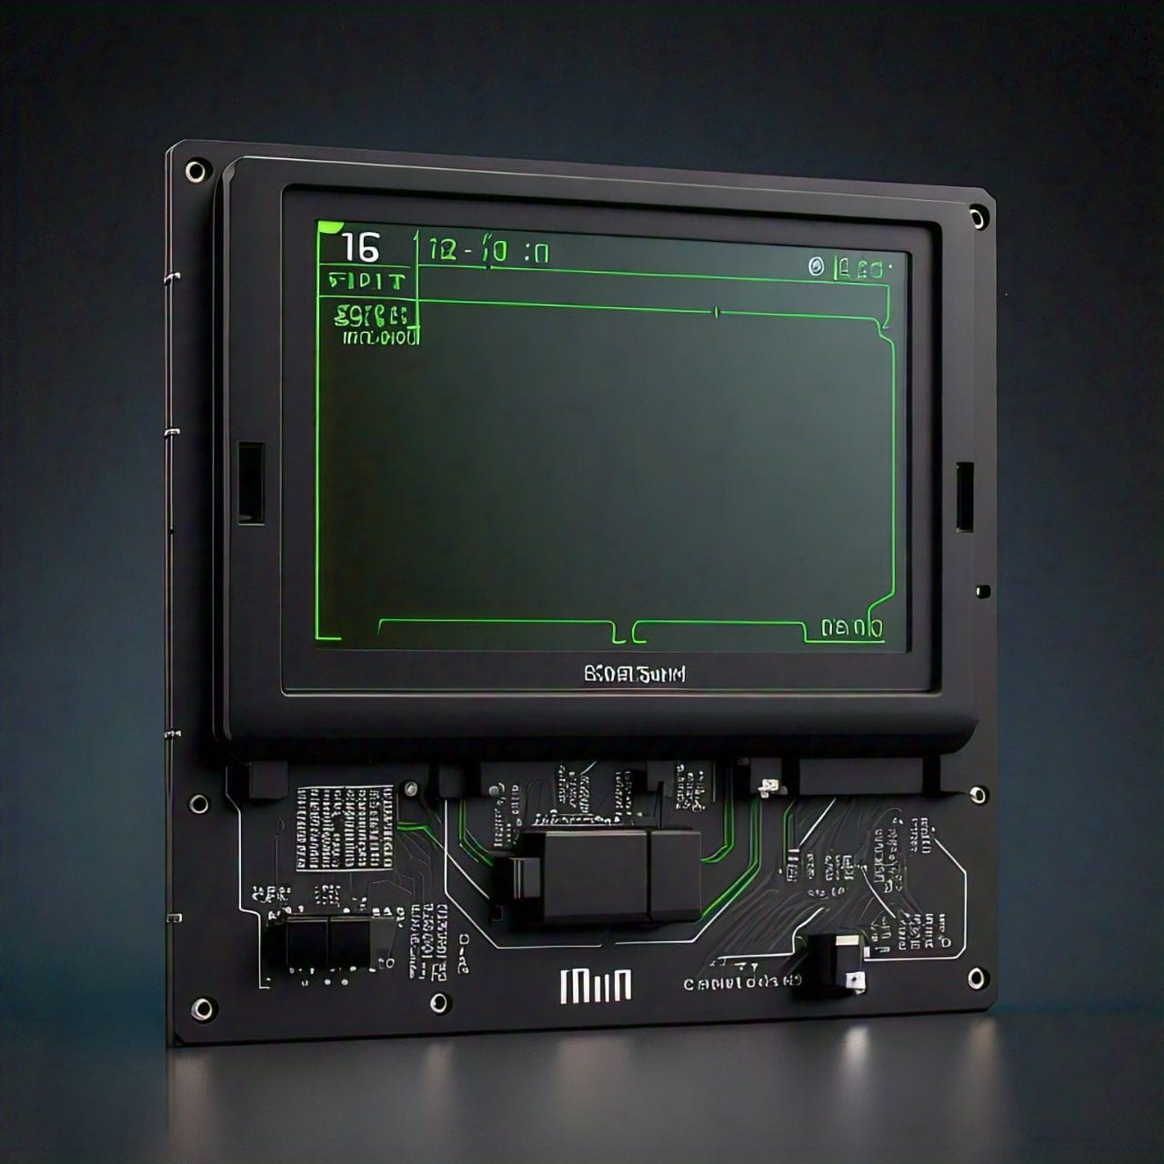
16*2 LCD Screen with I2C Interface
Display: The LCD screen displays real-time data on parking slot occupancy, indicating which slots are available or occupied.
Advantage: It offers clear and immediate feedback to users, making it easy for drivers to find available parking spots.
Details: The I2C interface simplifies the wiring and communication between the LCD screen and the Arduino, reducing the complexity of the setup.

Slide 6
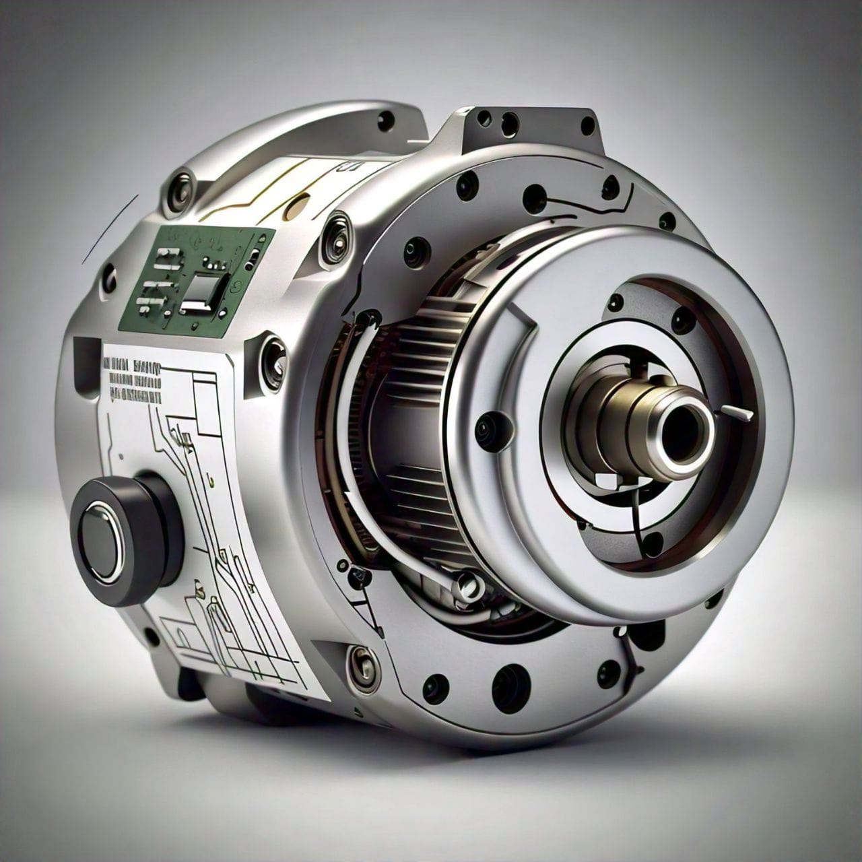
Servo Motor: Access Control
Function: The servo motor controls the entry and exit barriers of the parking area.
Mechanism: It opens the barrier only when a parking spot is available, preventing unauthorized access and ensuring efficient use of parking spaces.
Details: The servo motor provides precise and controlled movement, ensuring smooth operation of the barriers.

Slide 7
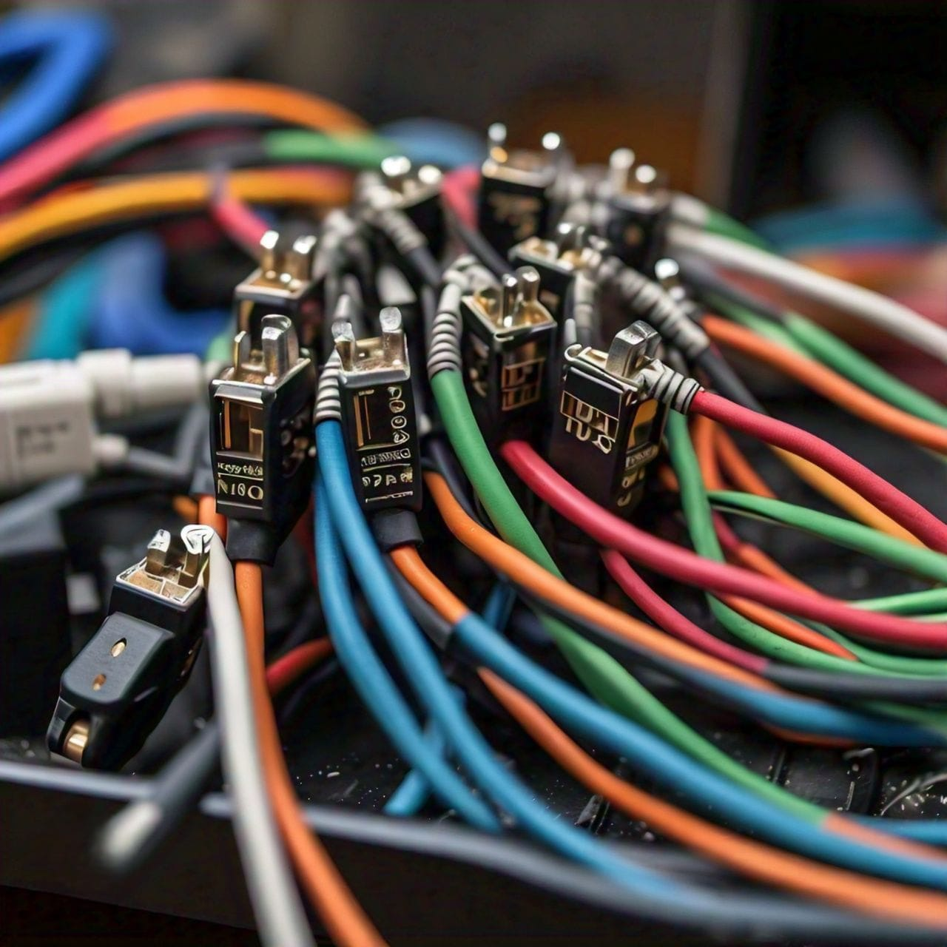
Jumper Wire: Connectivity
Purpose: Jumper wires are used to establish connections between the Arduino, sensors, LCD screen, and servo motor.
Benefit: They ensure reliable communication and power distribution among all components.
Details: Male-female jumper wires are used for easy and secure connections, allowing for quick assembly and troubleshooting.

Slide 8
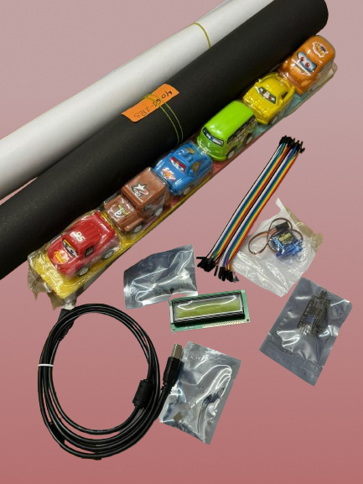
System Workflow
Arduino UNO
IR Proximity Sensors
16*2 LCD screen with an I2C Interface
Servo Motor
Jumper Wires
Explanation:
Sensors detect the presence of vehicles and send data to the Arduino.
The Arduino processes this data and updates the LCD screen with the current occupancy status.
If a parking spot is available, the Arduino signals the servo motor to open the barrier, allowing the vehicle to enter.

Slide 9
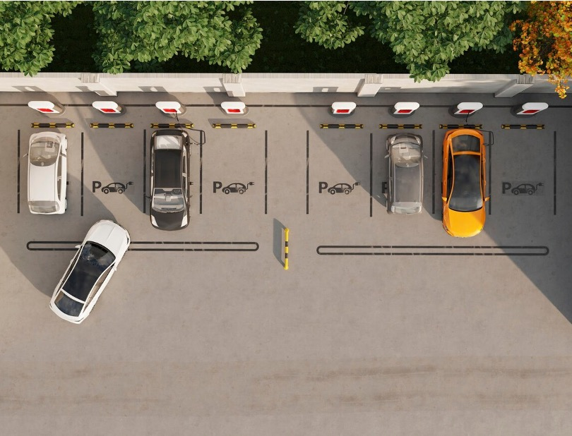
CASE STUDIES AND RESULTS
Several cities have successfully implemented smart parking solutions, demonstrating signiﬁcant improvements in traffic flow and user convenience. These case studies provide valuable insights into the effectiveness of such systems.

Slide 10

BENEFITS OF SMART PARKING
Efficiency:
Reduces the time drivers spend searching for parking spots, leading to less traffic congestion.
Optimizes the use of available parking spaces, ensuring that no spot goes unused.
Automation:
Minimizes the need for human intervention, making the system more reliable and efficient.
Provides a seamless parking experience for users, with automated entry and exit control.
Real-Time Data:
Enhances the user experience by providing up-to-date information on parking availability.
Helps in better management of parking resources, allowing for data-driven decision-making.

Slide 11

CONCLUSION AND FUTURE DIRECTIONS
Summary:
The Smart Parking System integrates various components to provide an efficient and automated solution for parking management.
Key components include the Arduino UNO microcontroller, RI proximity sensors, 16*2 LCD screen with I2C interface, and servo motor.
Future Scope:
Potential improvements include integrating mobile app support for remote monitoring and reservations, allowing users to check parking availability and book spots in advance.
Future developments could involve using more advanced sensors and AI for predictive analytics, further enhancing the efficiency and user experience of the system.

Slide 12

Thanks!

